Slide 1
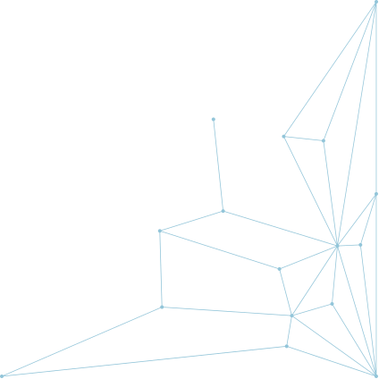




RANDOM WORLD GENERATION
EXPLORING ALGORITHMS, VISUAL STYLES, AND OPTIMIZATION TECHNIQUES
NAME:- SHUVRADEEP BERA
ROLL:- 24IE10042

Slide 2







INTRODUCTION
What is Procedural Generation?
Procedural generation is the practice of using algorithms to create game content (like maps, characters, items, etc.) automatically instead of manual creation.
Importance of Procedural Generation
Enhances replayability and unpredictability in games.
Procedural generation lowers manual labour, thus reducing development time and costs
Key Takeaways
Discussing algorithms like Perlin noise, simplex noise, cellular automata, and Voronoi diagrams.
Understanding their development, algorithm, applications, limitations and optimization techniques.

Slide 3

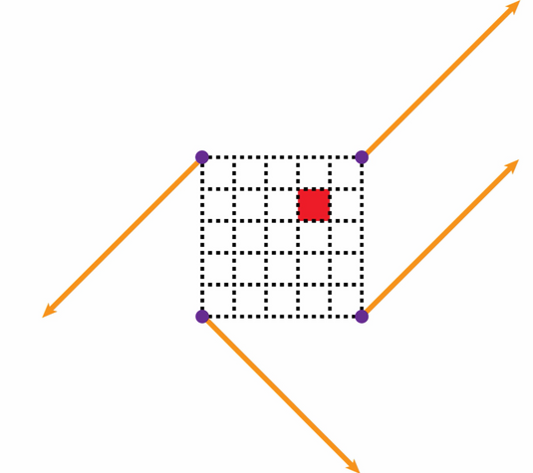
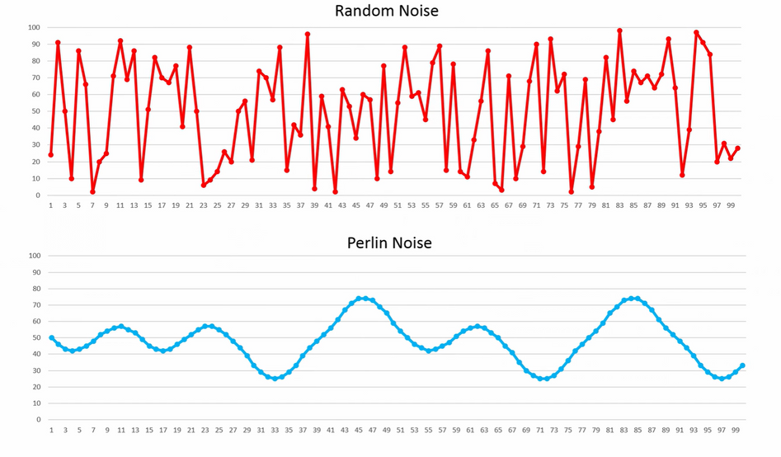

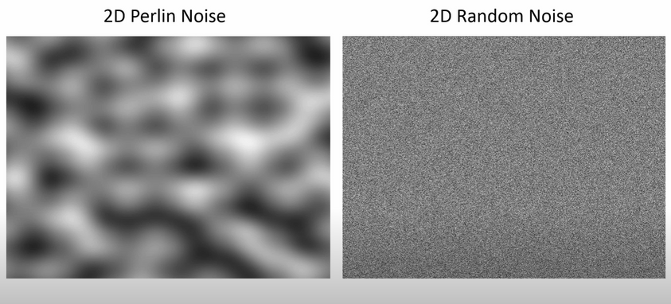
PERLIN NOISE
Algorithm
GRID GENERATION
Perlin noise operates on n-dimensional grid
Each grid point (or vertex) is assigned a random gradient vector
DOT PRODUCT
For any point within a grid cell, calculate the offset vectors from each corner of the cell to the point.
Dot product of each gradient and offset vector is computed
INTERPOLATION
Use these dot products to interpolate between the corners of the grid cell.
First top left and top right, then bottom left and bottom right
Then, interpolate these teo to get final noise at that point
FADE FUNCTION (EASE CURVE)
To ensure smooth transitions,an ease curve is used.
This function, typically 6t^5−15t^4+10t^3, is applied to interpolation parameters to make transitions more gradual and natural-looking
WHAT IS PERLIN NOISE?
Perlin noise is a gradient-based procedural noise algorithm developed by Ken Perlin in 1983. It generates smooth, natural-looking randomness

Slide 4
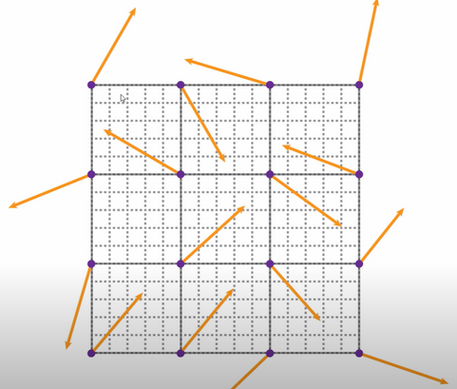
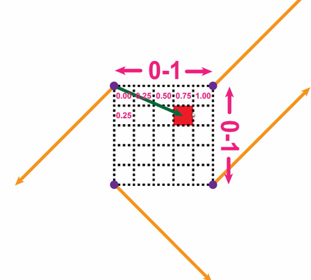
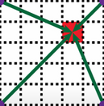
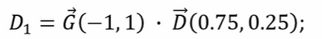
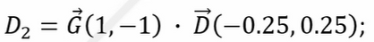
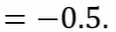
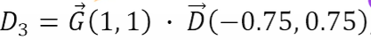
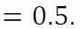
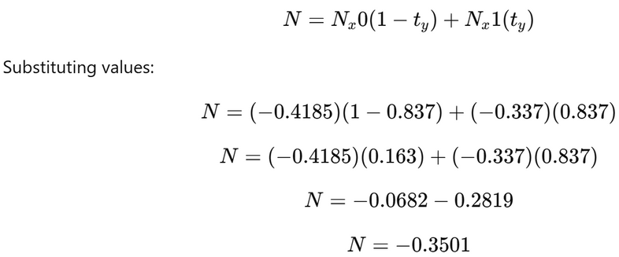
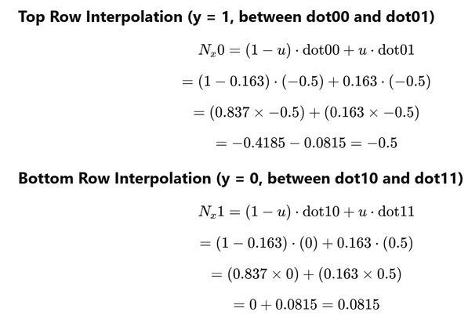
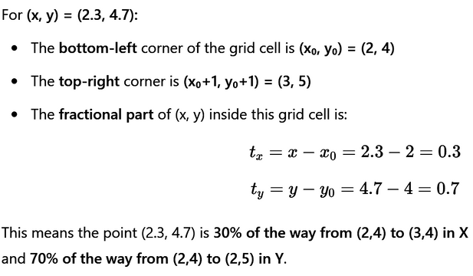
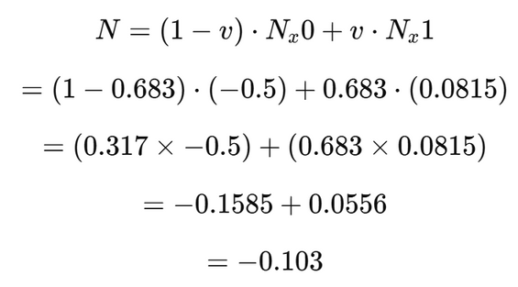
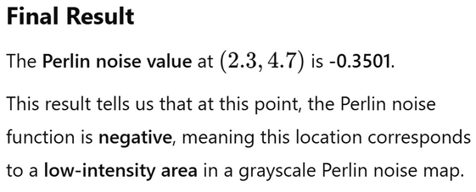
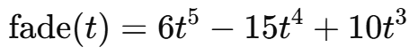
PERLIN NOISE ALGORITHM
Dot product computed gradient vector and pixel distance vector
One cell chosen and gradient vectors randomly generated
Diistance of each cell from different corners are measured and later used in dot product
Gradient vectrors assigned to various corners
Now these dot products are used along with fade function parameters
For eg.-
Interpolate along y-direction
Interpolate along x-direction
fade(0.3) ≈ 0.163
fade(0.7) ≈ 0.837

Slide 5

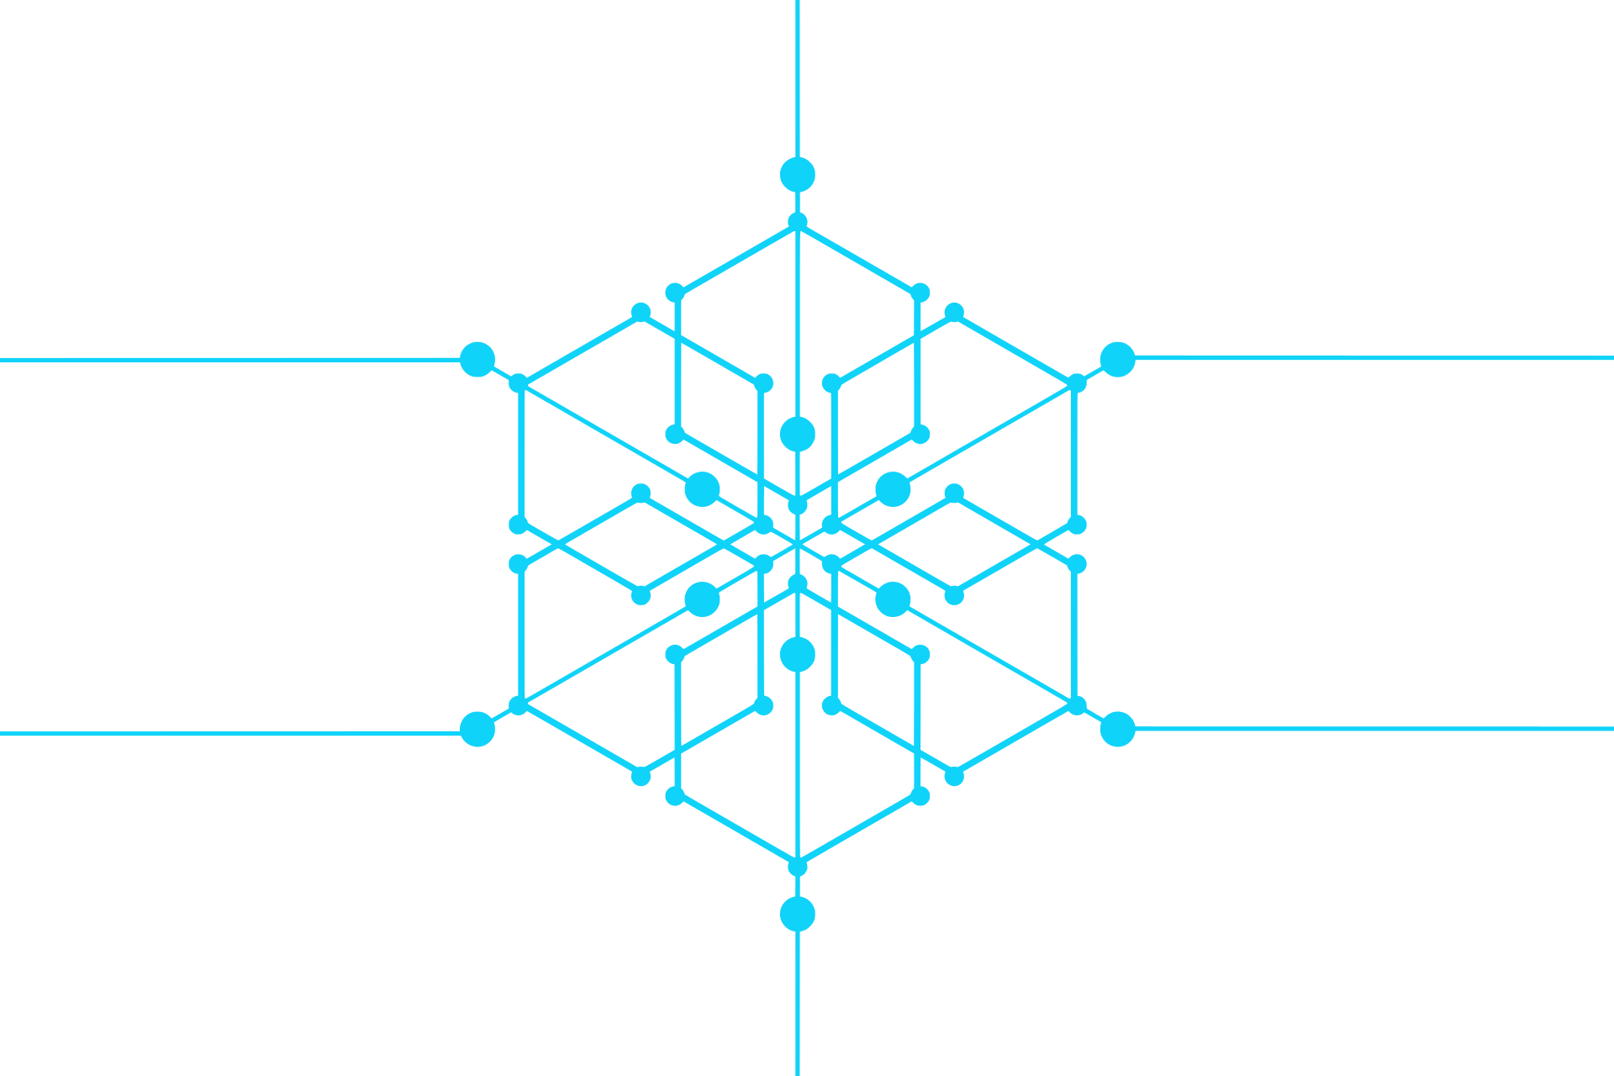
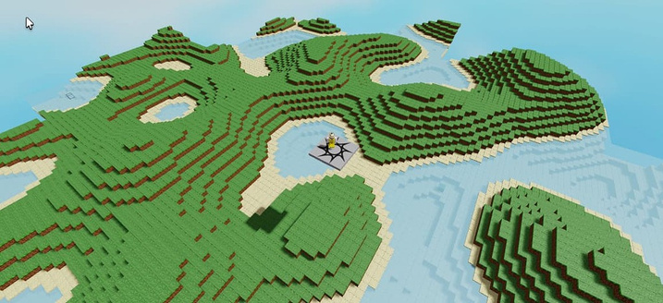
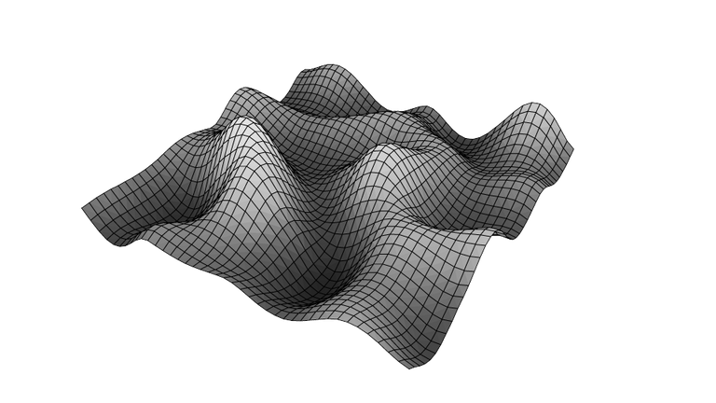
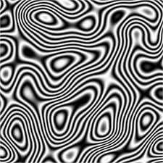
PERLIN NOISE
DISADVANTAGES
Can appear "blobby" or lack sharp features.
Computationally expensive for high dimensions.
KEY FEATURES
Smooth, continuous gradient noise.
Smooth and organic appearance that mimics natural textures and patterns
APPLICATIONS
Terrain generation (mountains, clouds, water).
Texture generation (wood, marble).
Example: Rolling hills or cloud formations.
OPTIMISATION
.Use precomputed gradients.
Limit the number of octaves in fractal noise.
Use SIMPLEX NOISE.
Mother Nature doesn’t use a random world generator—she just smudges the pixels until they look right!" 😆

Slide 6

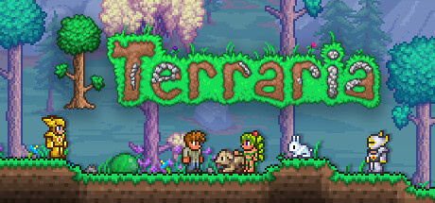
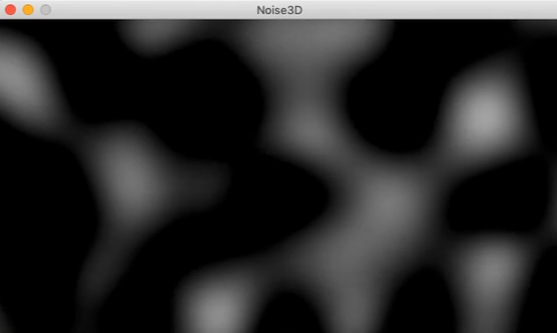
SIMPLEX NOISE
HOW IS IT DIFFERENT FROM CLASSIC PERLIN NOISE?
It has a complexity of O(n^2) for n dimensions, compared to O(2^n) for Perlin noise
Uses a simplex grid (triangles in 2D, tetrahedrons in 3D).
Unlike Perlin noise, which can exhibit noticeable grid patterns, simplex noise is visually isotropic
ALGORITHM
Coordinate Skewing: Transforming the input coordinates to align with a skewed grid, which helps in determining the simplex that contains the point.
Simplicial Subdivision: The space is divided into simplices [triangles, tetrahedrons]
Gradient vector selection and noise calculation by kernel summation.
WHY IS IT BETTER?
Reduced computational complexity, hence suitable for higher dimensions.
Minimized directional artifacts
Smoother transitions
WHAT ARE DIMENSIONAL ARTIFACTS?
Dimensional artifacts are unwanted patterns or distortions that arise when generating procedural noise, particularly in multi-dimensional spaces
GAMES WHICH USE PERLIN AND SIMPLEX NOISE FOR RANDOM WORLD GENERATON:-
MINECRAFT, FACTORIO, TERRARIA

Slide 7
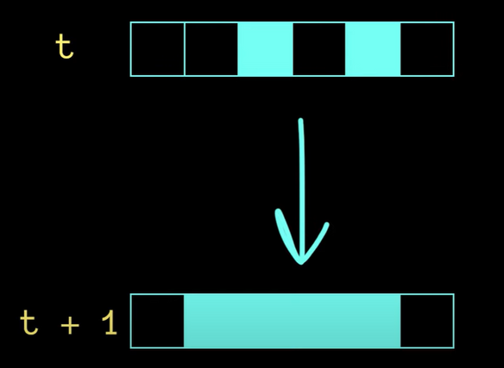
CELLULAR AUTOMATA
EXAMPLE TO DEMONSTRATE THE ALGORITHM:-
Let us take RULE 110:-
If Inital states of cell and neighbours are 1-> Final state =0
If Inital states of cell and neighbours are 0-> Final state =0
If cell and right neighbour is 0 but left neighbour is 1-> Final state=0
Else ->1
OVERVIEW
Cells live on a 1D or multidimensional grid.
Each cell has a state such as 0 or 1 or on and off.
The on or off state of a cell depends on a set of rules considering the initial states of its neighbouring cells
INITIAL STATE
VISUAL STYLE:-
Blocky, grid-like patterns.
Example: Jagged cave walls or maze-like dungeons.
APPLICATIONS:-
Generate organic-looking structures like forests or coral reefs in games.
Used in Parallel Processing, with each cell processing data individually
FINAL STATE
GAMES WHICH USE CELLULAR AUTOMATA FOR RANDOM WORLD GENERATON:-
GAME OF LIFE, DWARF FORTRESS

Slide 8
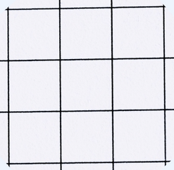
THE GAME OF LIFE
It is a “ZERO PLAYER GAME”, devised by John Horton Conway in 1970. It is built on 2D cellular automaton in which its evolution is determined by its initial state only
RULES OF GAME OF LIFE:-
Any live cell with fewer than two live neighbours dies (underpopulation).
Any live cell with two or three live neighbours lives on to the next generation.
Any live cell with more than three live neighbours dies (overpopulation).
Any dead cell with exactly three live neighbours becomes a live cell (reproduction).
EXAMPLE SIMULATION
1.Suppose there are initially 2 live cells
In the next iteration both the cells die by underpopulation
2. If initially there are 3 horizontal live cells
Cave Generation Example:
Initial Randomness: Start with a grid of randomly assigned "wall" and "floor" tiles.
Smoothing: Apply a rule that makes a cell more likely to be a "wall" if it has many "wall" neighbors, and more likely to be a "floor" if it has many "floor" neighbors.
Iteration: Repeatedly apply the rule to smooth out the random pattern and create cave-like structures.
Cells 1,3 have only 1 live neighbour so die.
Cells 4,5 have 3 live neighbours, so are reproduced.
[For cell 4, live neighbours
are 1,2,3]
4
4
1
2
3
1
2
3
5
5

Slide 9
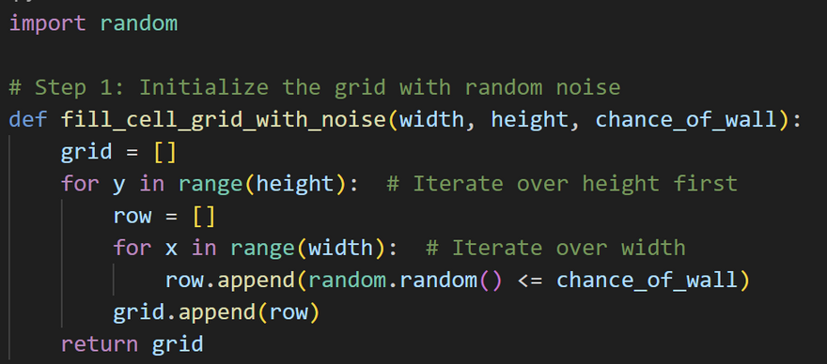
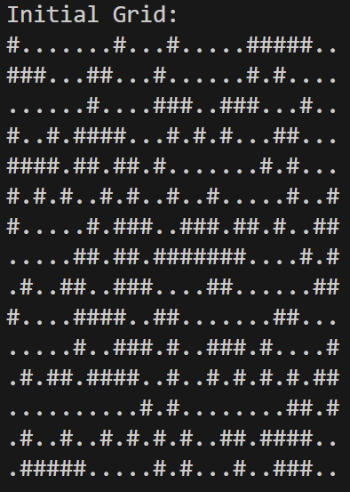
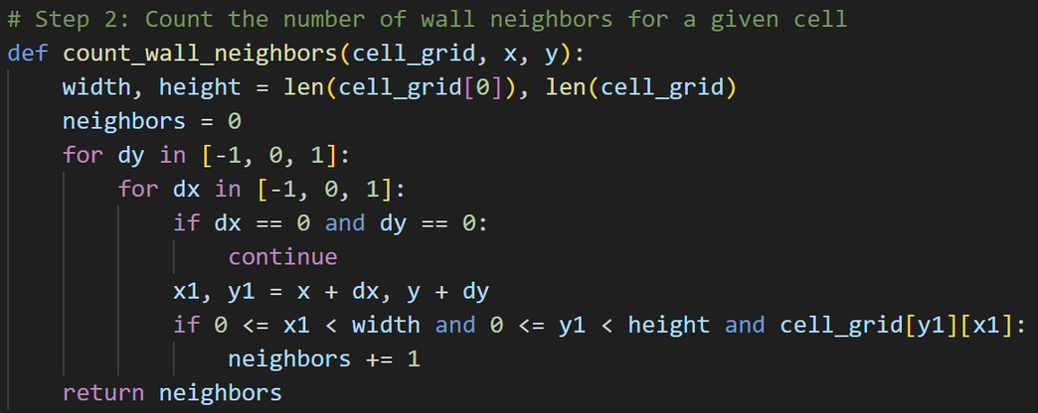
CAVE GENERATION USING CELLULAR AUTOMATA
1.Initialize the Grid with Random Noise:
Printing initial noise, where True values are printed with # and false ones with dot(.)
>
2. Count no. of neighbors of every cell to apply automata rules

Slide 10
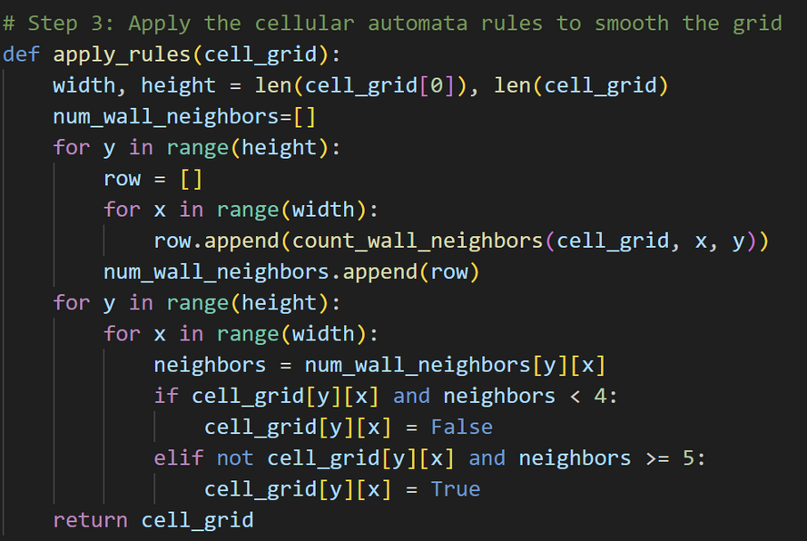
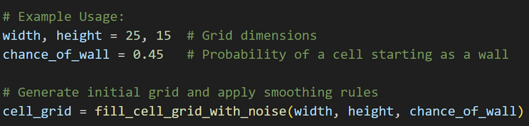
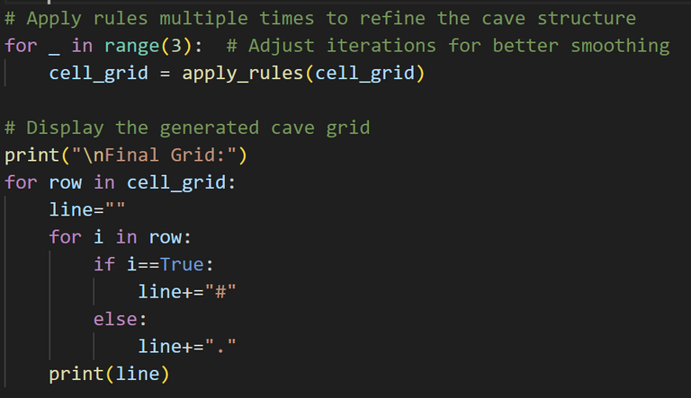
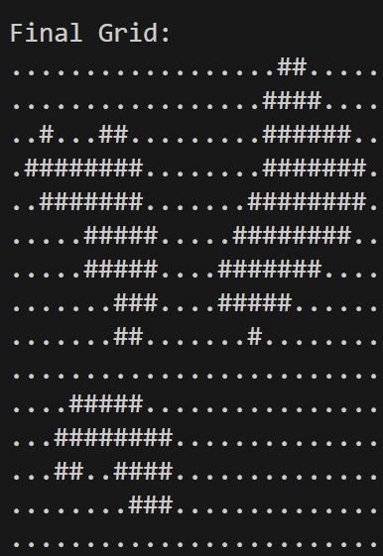
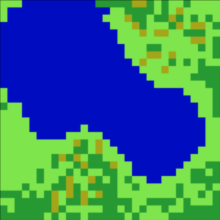
CAVE GENERATION USING CELLULAR AUTOMATA
3.Apply Cellular automata rules
4.Writing the print statements with dimension values
FINAL CAVE LAYOUT PRINTED.
AS SEEN FROM TOP(IN A MAP)
THESE MAPS CAN BE CONVERTED TO COLORED PIXELS MAPS BY APPLYING ALGORITHMS

Slide 11
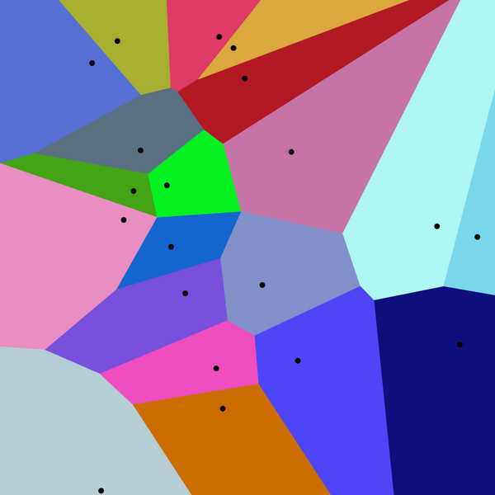
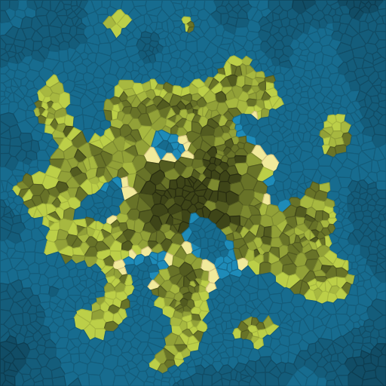
VORONOI DIAGRAMS
Voronoi diagram is a partitioning of a plane into regions based on the distance to a set of given points. These points, known as seeds, sites, or generators, define the structure of the diagram.
SOME OF THE COMMON ALGORITHMS:-
Fortune’s Algorithm: A plane-sweep algorithm that efficiently constructs Voronoi diagrams in time.
Incremental Insertion: Adds points one by one, updating the diagram iteratively. Each new point is inserted, and affected regions are adjusted accordingly.
Divide and Conquer: Recursively divides the set of points into smaller subsets, constructs Voronoi diagrams for each subset, and then merges them
Each region consists of all points closer to one seed than to any other.
VORONOI DIAGRAMS IN WORLD GENERATION:-
Terrain Generation: Used to create diverse terrain types by assigning different features (e.g., mountains, forests) to each cell based on the seed point's properties.
Natural patterns like river networks or geological formations
Used in designing maps in games, with settlements, islands etc.

Slide 12
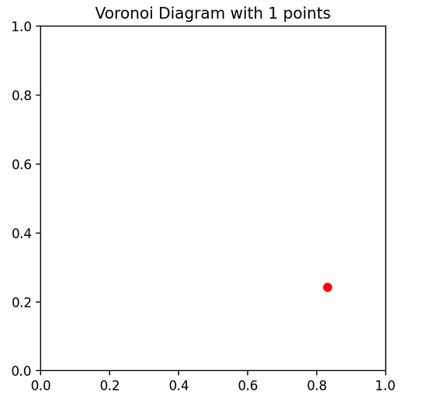
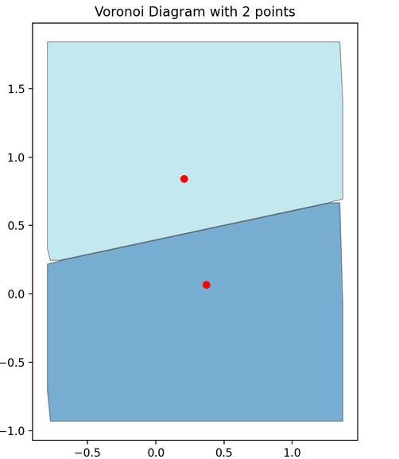
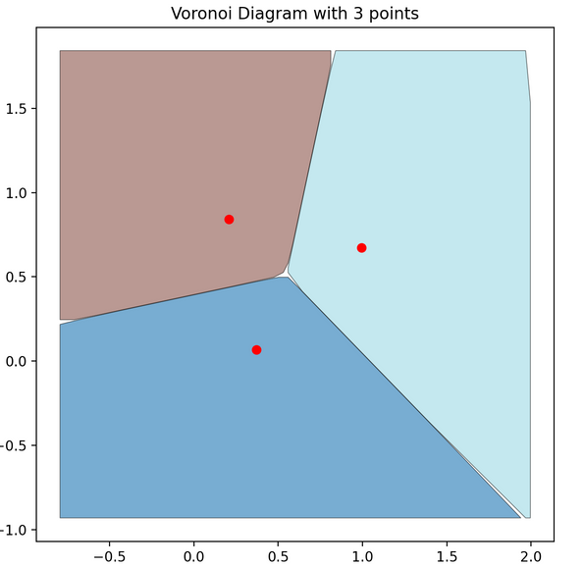
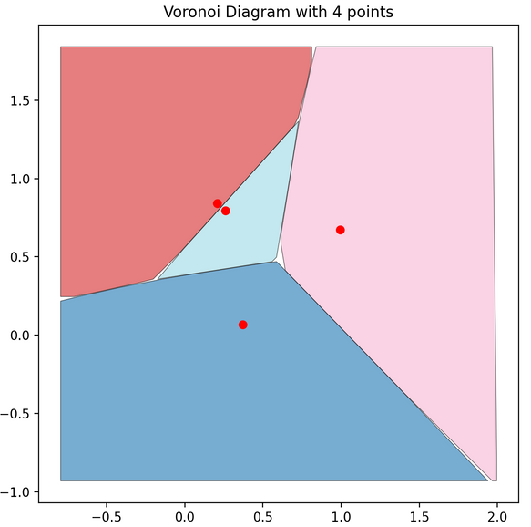
INCREMENTAL INSERTION
Algorithm
1. Initialize an Empty Diagram
Begin with an empty plane where no points exist.
2. Insert the First Point
The first point inserted occupies the entire plane as its Voronoi cell.
Since there are no other points, no edges or boundaries are needed.
3. Insert the Second Point
Compute perpendicular bisector between the two points:
Find the midpoint between the two points.
Compute the perpendicular slope.
Extend the bisector infinitely in both directions.
This bisector divides the plane into two cells, one for each point.
4. Insert the Third Point and Beyond
For each new point:
Locate the nearest neighboring points.
Compute the midpoint between the new point and each of its neighbors.
Compute the perpendicular bisector.
Extend the bisector until it intersects existing edges.
Remove parts of old Voronoi cells that now belong to the new point.

Slide 13
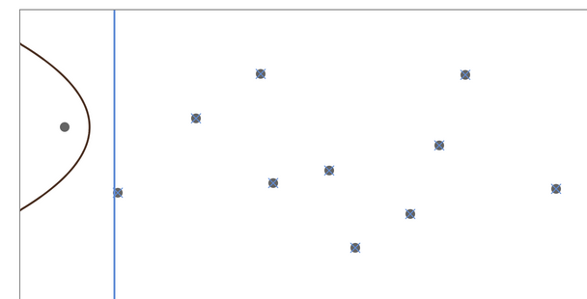
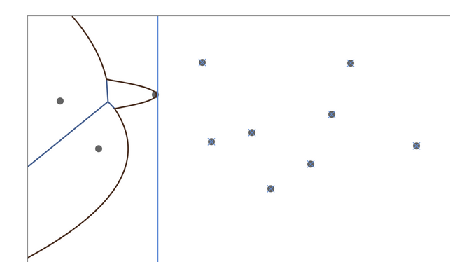
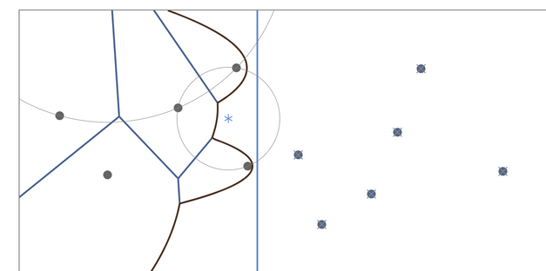
DRAWBACKS OF INCREMENTAL INSERTION
High Cost of Updates:- Voronoi diagrams requires frequent updates to the structure as new sites are added.
As the number of points increases, the computational overhead grows significantly.
Special cases such as collinear points or closely spaced points can lead to numerical instability.
FORTUNE’S ALGORITHM
THUS, WE NEED A BETTER ALGORITHM
---->FORTUNE’S ALGORITHM
Advantages of Fortune’s Algorithm
Fast: Runs in O(n log n) time, making it more efficient than naive approaches.
Handles Large Datasets: Can compute Voronoi diagrams for thousands of points efficiently.
Robust: Works well for both finite and infinite Voronoi cells.
Fortune’s Algorithm efficiently constructs Voronoi diagrams in O(n log n) time using a sweep-line approach.
It processes points (site events) from top to bottom while maintaining a beach line of parabolic arcs.
When arcs disappear (circle events), Voronoi vertices are created, and edges are extended.
The algorithm completes when all edges are formed and extended to infinity.
VISUAL CHARACTERISTICS OF VORONOI DIAGRAMS
Consist of polygonal regions with sharp edges
Settlement patterns, river and road network and other sharp features.

Slide 14
DIFFERENCES BETWEEN THE ALGORITHMS
FEATURE | PERLIN NOISE | SIMPLEX NOISE | CELLULAR AUTOMATA | VORONOI DIAGRAMS
TYPE | Gradient Noise | Gradient Noise | Rule-Based Grid Evolution | Space Partitioning
VISUAL STYLE | Smooth and continuous | Smoother and less aliasing | Discrete and abrupt changes | Sharp cell boundaries
EFFICIENCY | Moderate (computationally expensive in higher dimensions) | More efficient than Perlin Noise | Efficient for small grid sizes, can be slow for large worlds | Depends on chosen algorithm. Slow for large no. of seed pts.
OPTIMIZATION TECHNIQUES | Precompute noise in chunks Use octaves for smoother transitions | Use lookup tables for faster computation | Use multi-threading Apply early stopping | Optimize seed distribution to avoid clustering
USE CASES | Terrain generation, clouds, textures | Terrain generation | Cave systems, map generation | Biomes, city layouts, natural formations

Slide 15

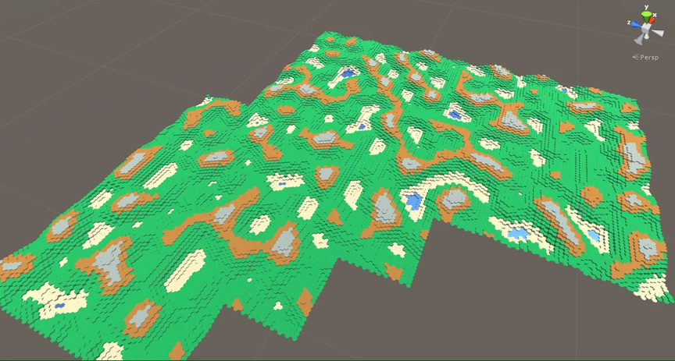
CONCLUSION
OFTEN THESE ALGORITHMS ARE USED TOGETHER TO OBTAIN THE DESIRED WORLD IN GAMES
TERRAIN GENERATION IN GAMES (MINECRAFT-
STYLE WORLDS)
Perlin/Simplex Noise: Used for generating base terrain elevation (hills, mountains, valleys).
Voronoi Diagrams: Used for dividing the world into distinct areas like forests, deserts,etc.
Cellular Automata: Used for cave generation, ensuring caves are connected and have natural-looking shapes.
CITY GENERATION (SIMCITY-STYLE GAMES)
VOronoi Diagrams: Helps create road networks and district layouts.
Perlin Noise: Used for elevation changes and terrain shaping.
Cellular Automata: Simulates urban expansion and building placement.
Dungeons & Rogue-like Maps
Perlin Noise: Used for large-scale dungeon layouts with smooth pathways.
Cellular Automata: Creates cave-like rooms with natural formations.
Voronoi Diagrams: Used to ensure varied room shapes and sizes.
SUMMING-UP
Procedural world generation is a powerful tool that blends multiple algorithms to create rich, dynamic environments. Techniques like Perlin noise, simplex noise, Voronoi diagrams, and cellular automata each bring unique characteristics, and when used together, they enable more realistic and diverse landscapes.

Slide 16

THANK YOU!

